Slide 1

Support Vector Machine
An Introduction to Machine Learning

Slide 2

Problem Statement
Understand in detail the SVM classification technique. Apply it on the loan dataset using three different types of kernel and compare the performances.
Prepare a few slides to present your results.

Slide 3

Support Vector Machine
a supervised machine learning algorithm
used for both classification and regression
Advantages
Effective in high dimensional cases
Its memory efficient as it uses a subset of training points in the decision function called support vectors
Different kernel functions can be specified for the decision functions and its possible to specify custom kernels

Slide 4

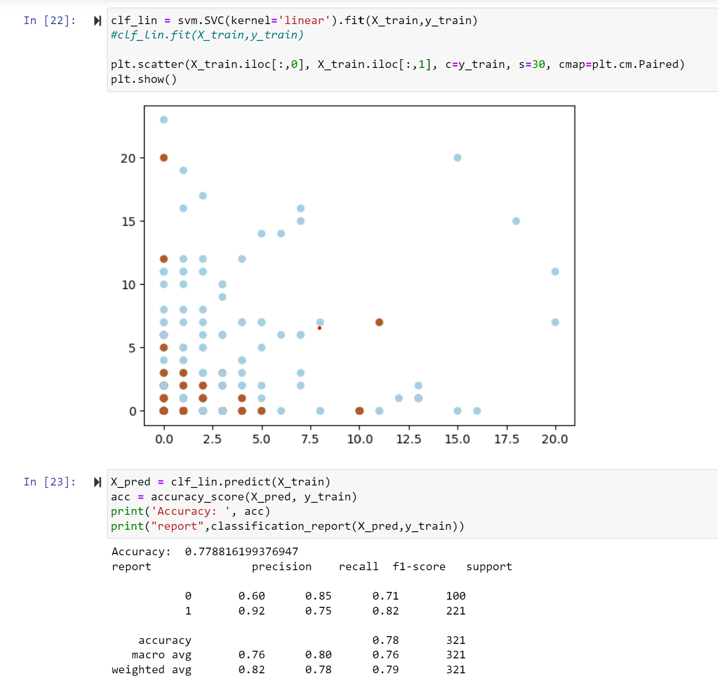
Performances in different kernels
a. Linear

Slide 5
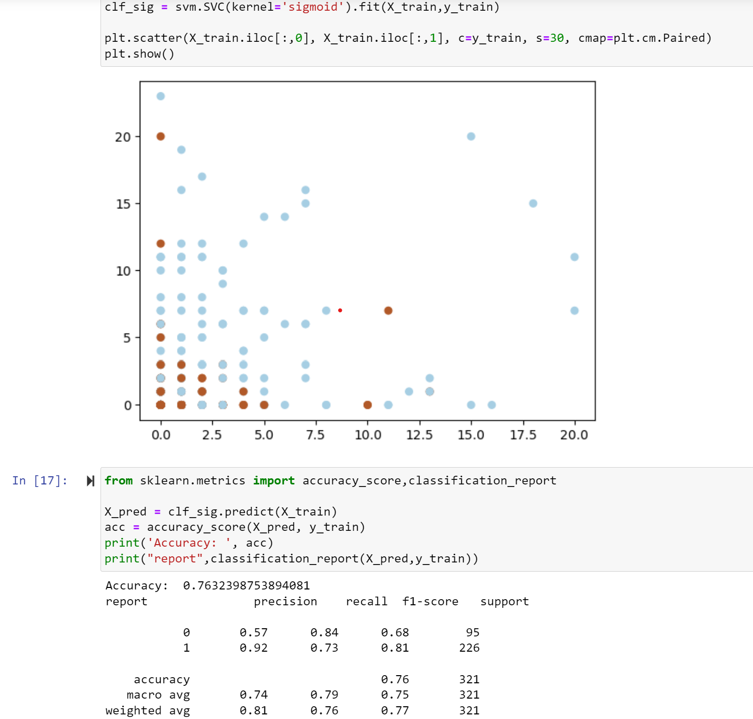
Performances in different kernels
b. Sigmoid

Slide 6
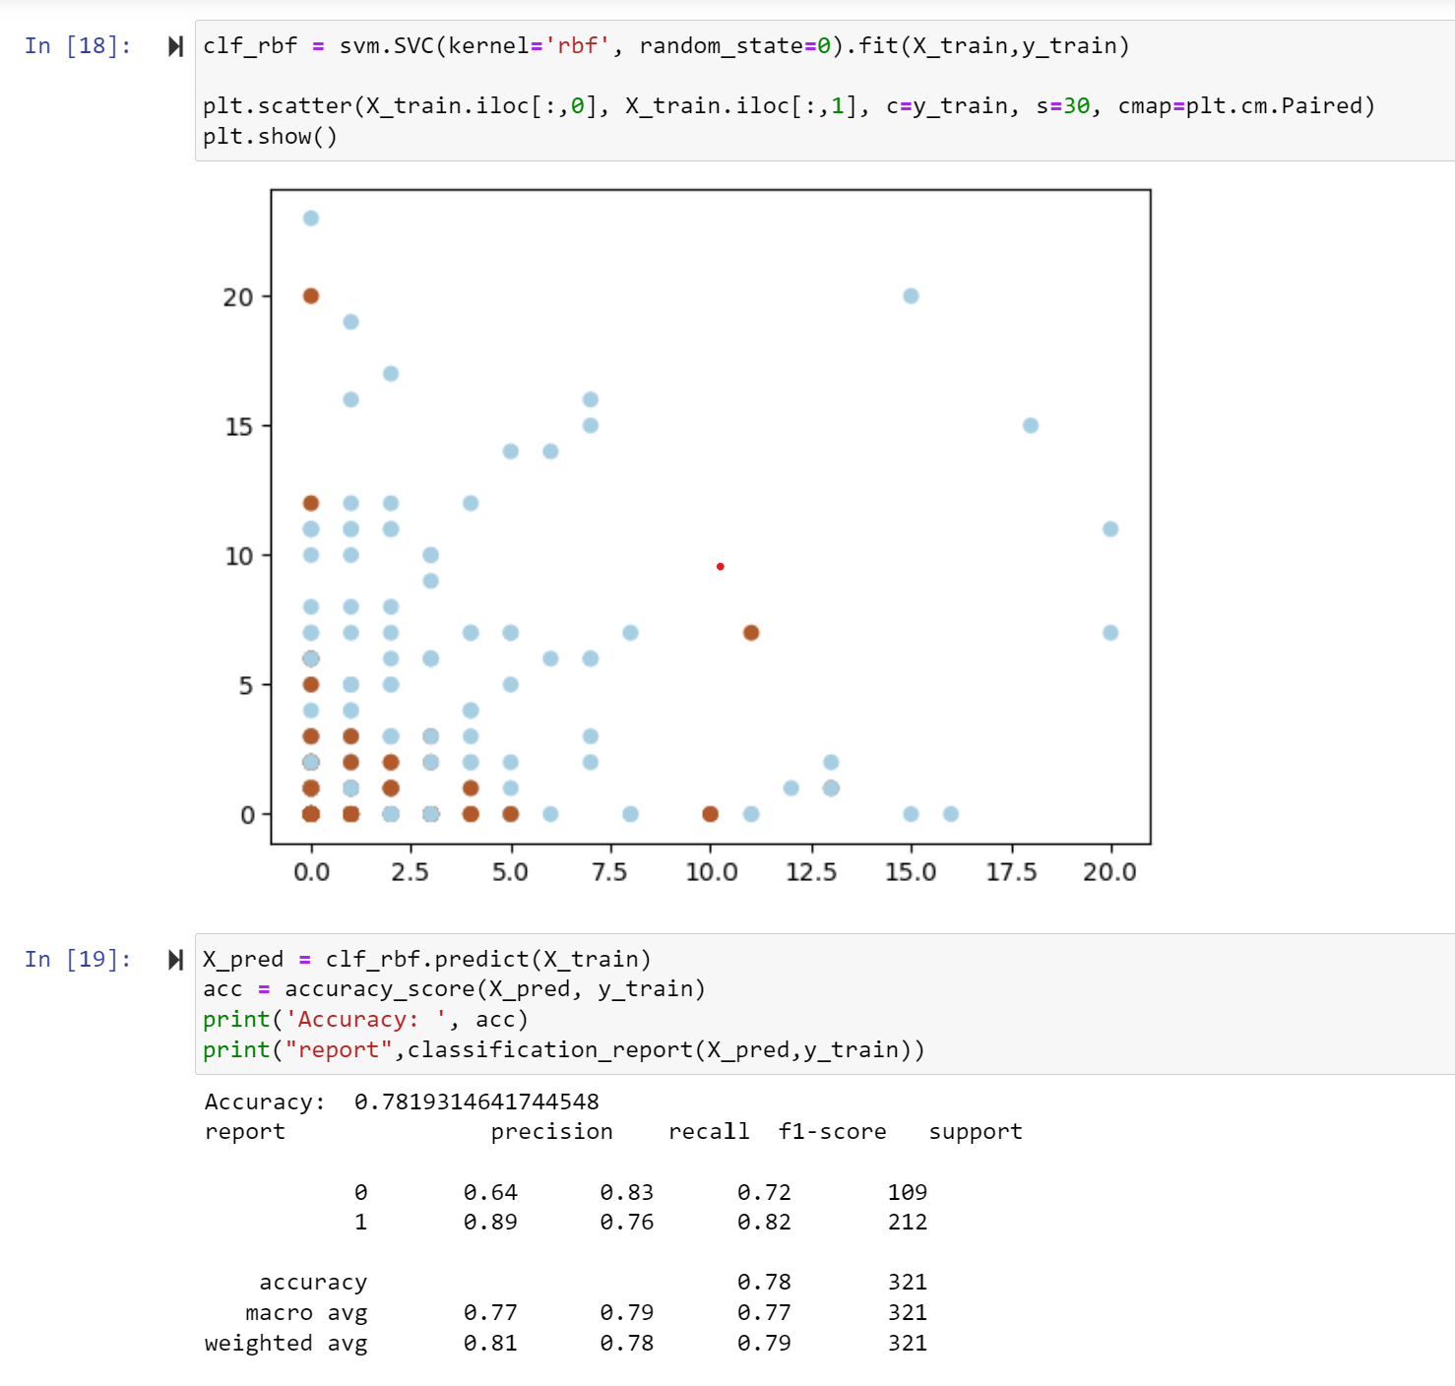
Performances in different kernels
c. RBF

Slide 7
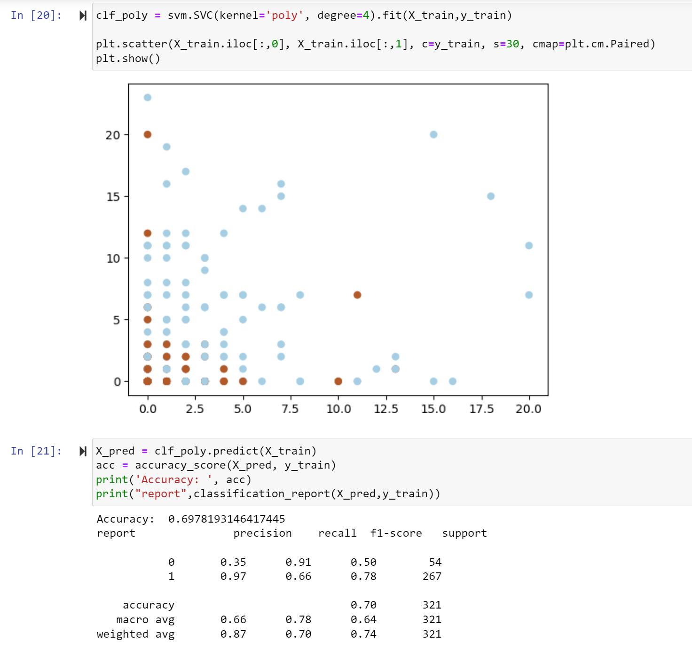
Performances in different kernels
d. Poly

Slide 8

Conclusion
SVM works by finding the optimal hyperplane that separates the classes in the data with the largest margin
effective in high-dimensional spaces and can handle complex datasets with non-linear decision boundaries
can be sensitive to the choice of kernel function and parameters
computationally expensive for large datasets

